Slide 1
Unified Mentor Internship

Slide 2
Big Game Census Analysis
ID – UMIP9740
By – Sudeep Kumar Larka

Slide 3
01
Problem
02
Table of contents
Dataset Overview
03
KPI
04
Dashboard
05
Conclusion

Slide 4

Super Bowl or Big Game
The Super Bowl is the official name of the championship game in American football, held annually by the National Football League (NFL). It’s a highly anticipated event, featuring top teams competing for the title.
However, due to trademark restrictions, non-sponsoring companies often avoid using the term “Super Bowl” in their advertisements. Instead, they refer to it as the “big game” or other generic terms1. So, while they’re closely connected, the names serve different purposes.

Slide 5
01
Problem vs. solution

Slide 6

Problem Statement
This Big Game Census data visualization takes a fun look at where Super Bowl 52 players come from, the related population figures, and opens up pathways (via embedded links) to additional census data points. The dataset came about when two hapless data nerds had their teams eliminated from the playoffs, thus turning to data to try to find more rooting interests for Super Bowl 52. The rosters for both, competing teams are included, with the corresponding roster information and birthplace and state population information. The developers utilized census data pulled from census.gov, and roster information from Yahoo Sports, and designed the data visualization within the Tableau platform.

Slide 7
02
Dataset Overview

Slide 8
Big Game Census Data
Player Name
Player Position
Jersey Number
Player Age
Player Weight(lbs)
Years Played
Birth City
Birth State
Birth Place(combo)
Player College
Player Team
Conference
2016 Population
State GEO ID
Latitude
Longitude
Number from city
Number of Records
American FactFinder Link for more Census data points
Quickfacts Link
State Data Link
Source (Population States 2017)
Birthplace, Population Data Source

Slide 9
03
KPI

Slide 10
KPI
Age Total Players Avg Years Played

Slide 11
04
Dashboard

Slide 12
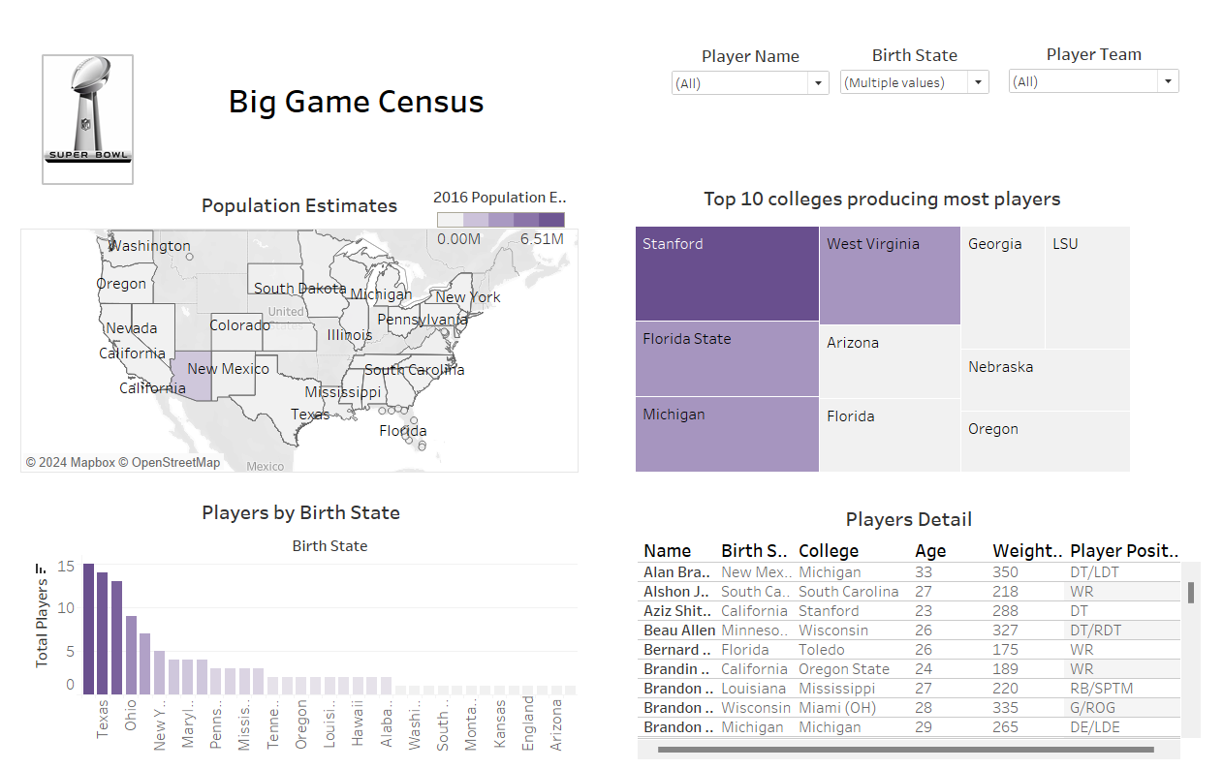
Tableau Dashboard

Slide 13
05
Conclusion

Slide 14
Conclusion
The Big Game Census graphic provides important context for understanding the participants in Super Bowl 52. The top three birth states are Texas, Ohio, and California, suggesting that these areas have a vibrant football culture. Top universities that produce NFL players include Stanford and Florida State, which highlight their excellent football programs. The visualization, which shows the athletes' educational and geographic paths, skillfully blends demographic data with sports rosters. Fans now have even more ways to engage with professional football thanks to this study, which not only emphasizes the diversity of player origins but also offers a greater knowledge of the demographic patterns driving the sport.

Slide 15


Thank You

